Slide 1
Practice Accessibility
For PowerPoint by Shawn Jordison

Slide 2
Practice (1)
These slides will cover the following practice elements
Duplicate slide titles
Design theme
Everything is in outline view
Alternate text
Tables
Links
Lists
Reading order
Accessibility check

Slide 3

Practice (2)
Accessibility does not have to be difficult.
Accessibility equals usability
When creating an accessible file, its important to understand that formatting effects everyone.

Slide 4
Practice (3)
Table requirements | Why it matters
Table headers | Table headers help with navigation for people who use a screen reader. Without table headers, its Impossible to determine the focus point in any give cell
Table Summary | Table summary provides a quick snapshot to the data in the table. It’s the equivalent of a visual scan
Avoid Merged cells | Merged cells can cause data confusion. Imagine each cell has a table header; when merged cells are added, it causes some data cells to possibly be connected to multiple headers.
What do tables need?
Tables need a table header, a summary, and avoid using merged cells

Slide 5
Practice (4)
Shawn Jordison’s Guide for accessibility

Slide 6
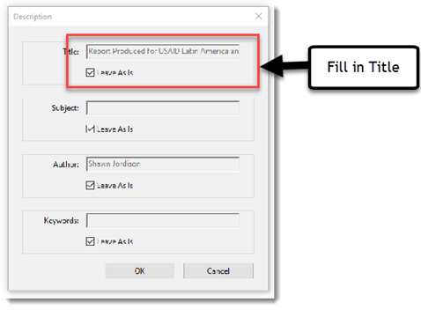
Specific Alt Text Practice
Some context for writing alt text:
Picture of filling in the title for accessibility within adobe acrobat

